Slide 1
Grand Central
Kam Amir
Getting Cloud Data into Splunk

Slide 2
Problem Statement
How to enable (cloud) Data-to-Everything?
Customers are struggling to configure and collect data from cloud providers. They are unable to gain visibility from their cloud deployments and are being exposed to operational, security and business vulnerabilities.
Traditionally Splunk has not been the easiest product to get data in, especially from third party providers.
The problem is only getting worse since “Cloud First” is creating a scale issue that customers cannot keep up with.

Slide 3
AWS GDI by the numbers
Manually setting up AWS Services and collecting the data with Splunk
1 account
1 region
3 AWS Service
(CloudTrail, Config, GuardDuty)
~150 clicks
~45 minutes per account, per region
50 accounts
4 regions
3 AWS Services
~150 hours or 1 week
500 accounts
4 regions
3 AWS Services
~1500 hours or 2 months

Slide 4
Problem for Cloud GDI
Setting up data collection per cloud, account, and region takes a great deal of time.
Different teams setup collection in a different way
Can’t see or discover accounts being added to Organization
Tools
Tools
Tools
Tools
Dev Team
Dev Team
Dev Team
Security Team

Slide 5
Grand Central
Current state and update to deliverables

Slide 6
Cloud Data Lifecycle
Managed and monitored by Grand Central
Central deployment mechanism across clouds, accounts and regions
Uniform data collection methodology
Alert new, updated or deleted accounts
Critical to the full lifecycle of the customer cloud data
Vend New Account
Alert new account
Configure Data Collection
Send Data to Splunk
Detect updates to accounts

Slide 7
How does it work?

Slide 8
Grand Central Prerequisites
High level overview of how this system works
Prerequisites
AWS Organizations Enabled
Kinesis Data Firehose
Splunk 7.0+
Setup IAM Policy
Setup IAM Policy and attach to an IAM user either done manually or using included CloudFormation template
Credentials
Collect credentials.csv files and create all_accounts.json
Install Grand Central App
The app can be installed on a search head and requires internet access (at least access to your AWS deployment)

Slide 9

Credential Smusher
Take all credentials.csv files and smush them into one file for upload
Step 1 – Download Credentials
Step 2 – Run credentials_smusher.py
Step 3 – Save File
Credentials
bash$ cd credentials/
bash$ python credentials_smusher.py
bash$ ls
all_account_credentials.json
Credentials
Credentials.csv
Credentials-1.csv
Credentials-2.csv
Credentials-3.csv
….
Credentials-n.csv
all_account_credentials.json

Slide 10

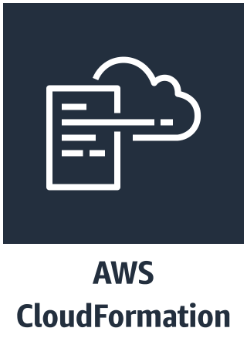




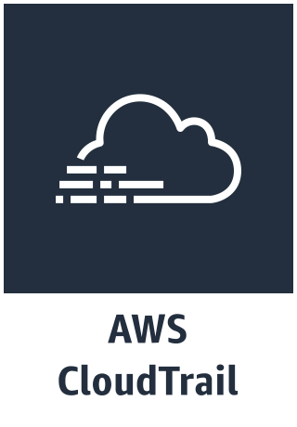
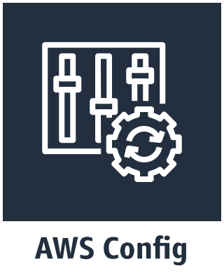
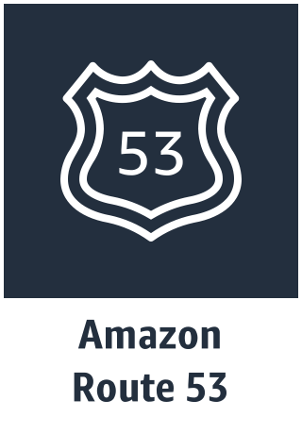

Grand Central Workflow
Master Account
Security Account
Role
Policy
Template
Template
Role
Policy
Logging Account
Shared Services Account
Template
BYOL
Splunk Cloud
Role
Policy
Sub Account
Template
Firehose -> HEC
Pull Mod Input
Splunk Blog Project Trumpet
GitHub Repo
Role
Policy

Slide 11
Demo

Slide 12
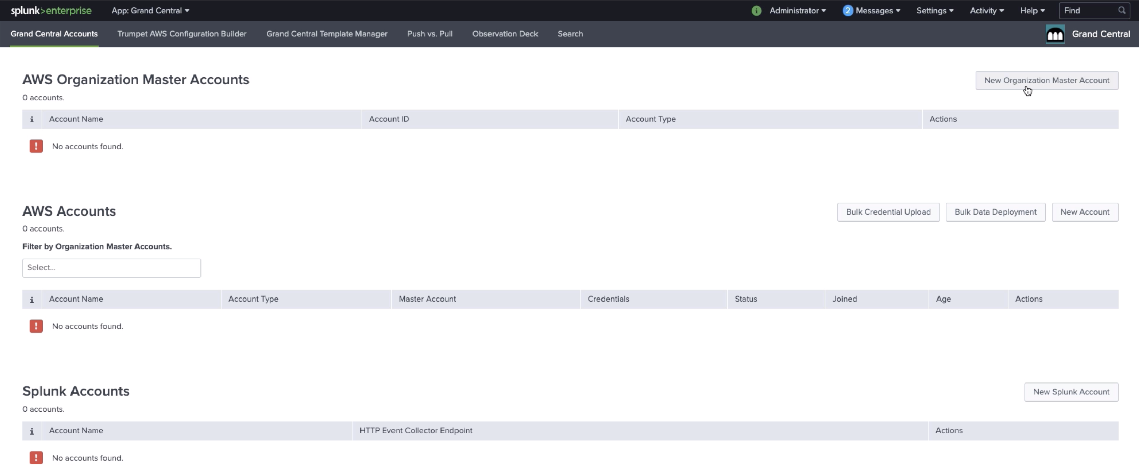

Slide 13
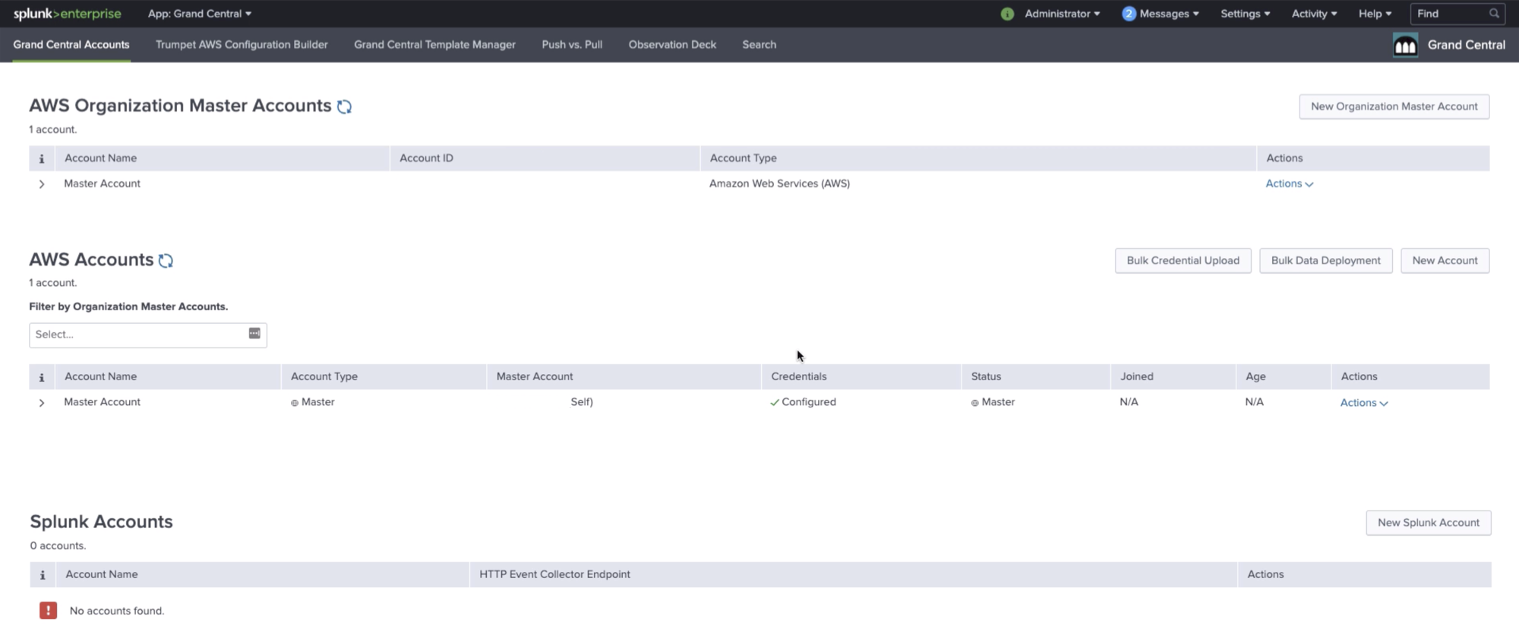

Slide 14
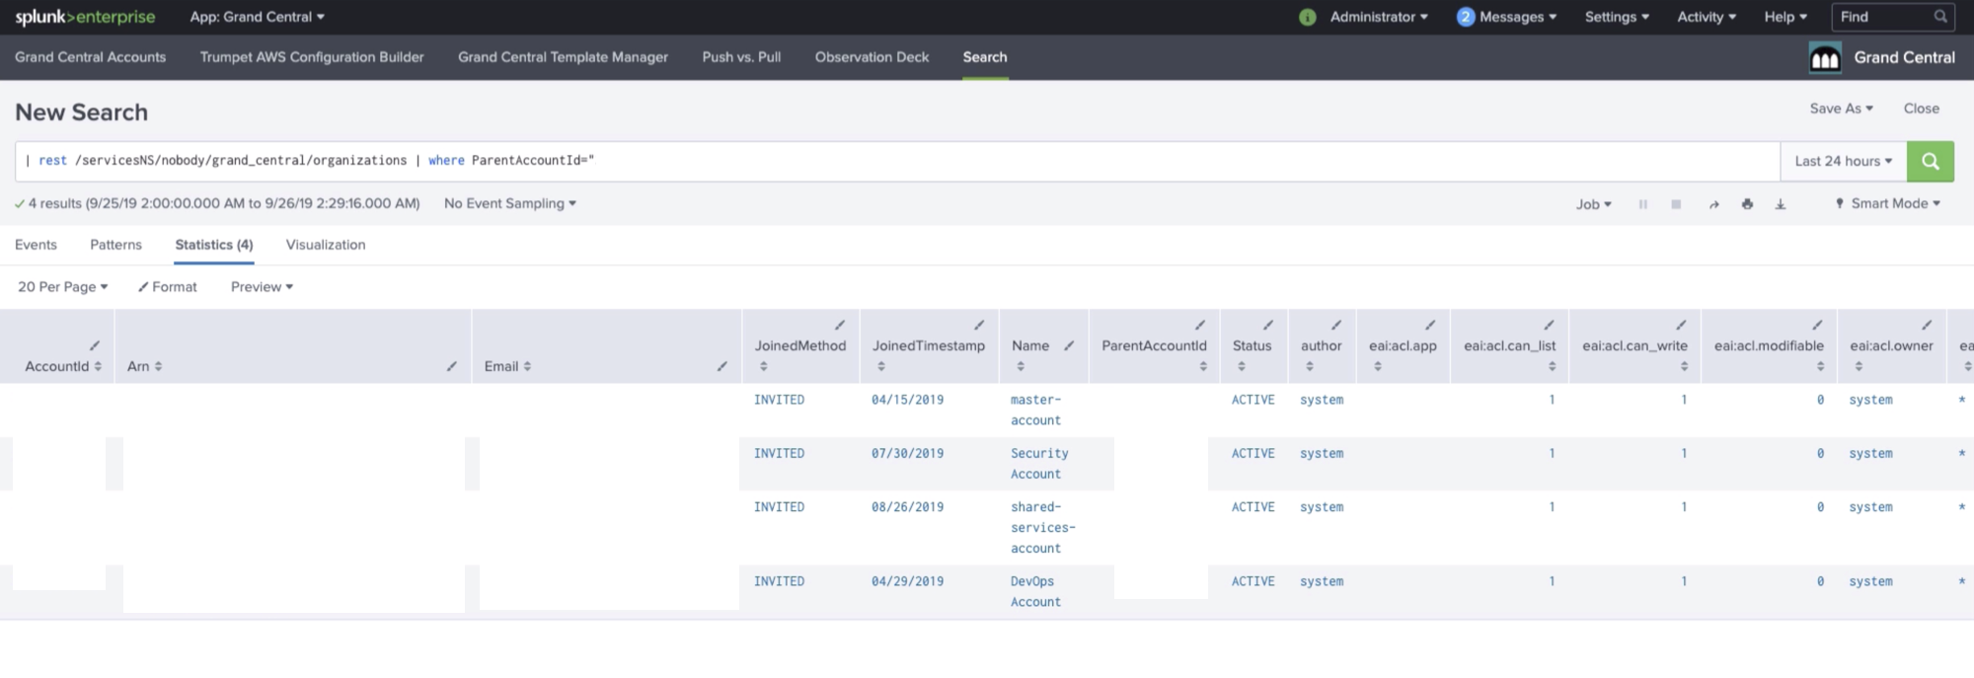

Slide 15
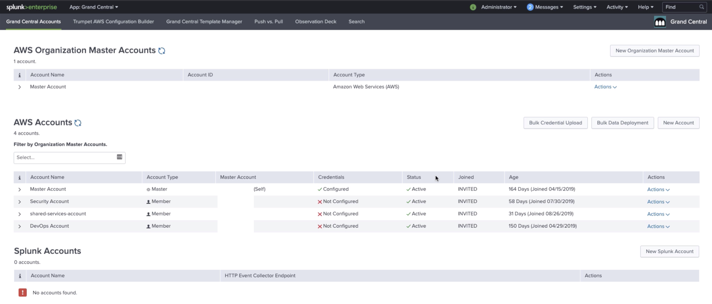

Slide 16
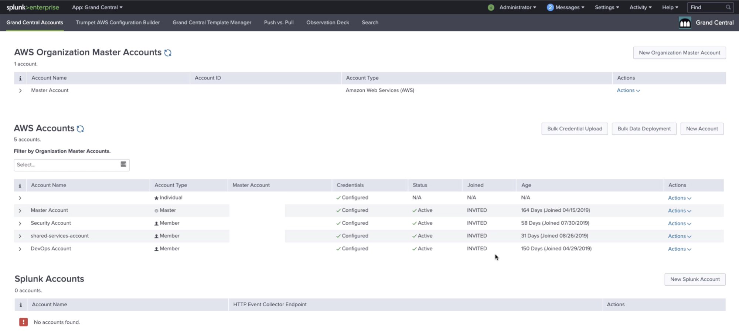

Slide 17
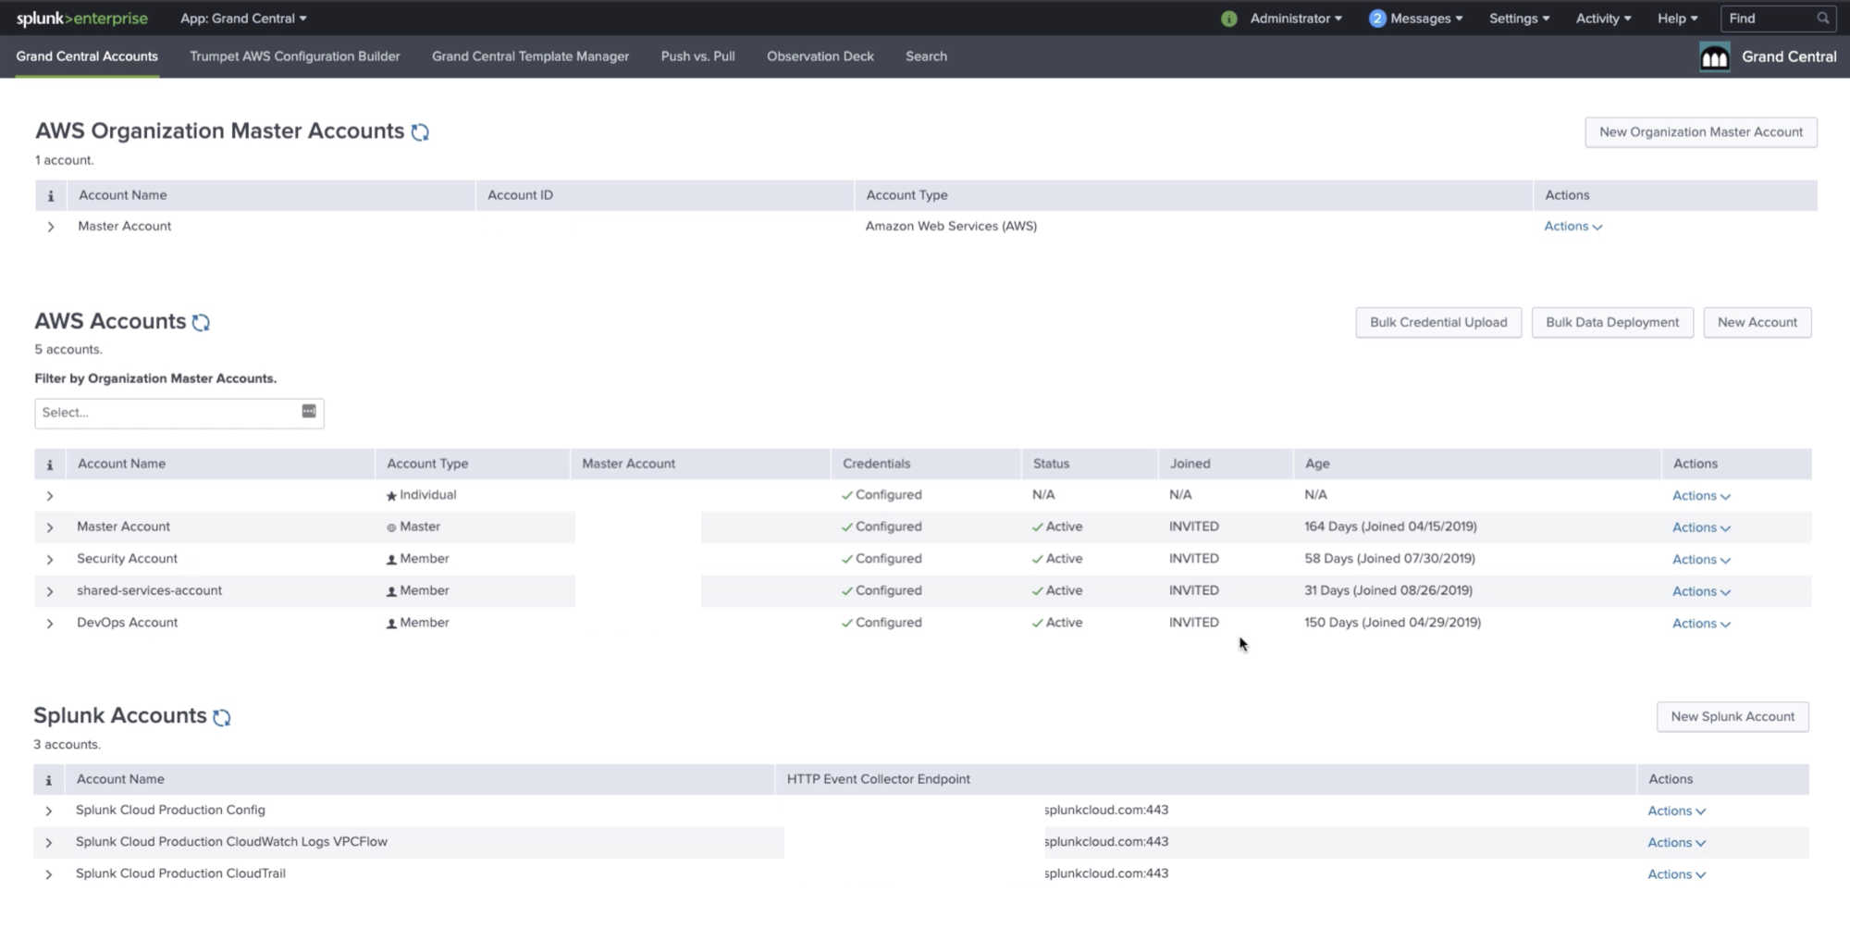

Slide 18
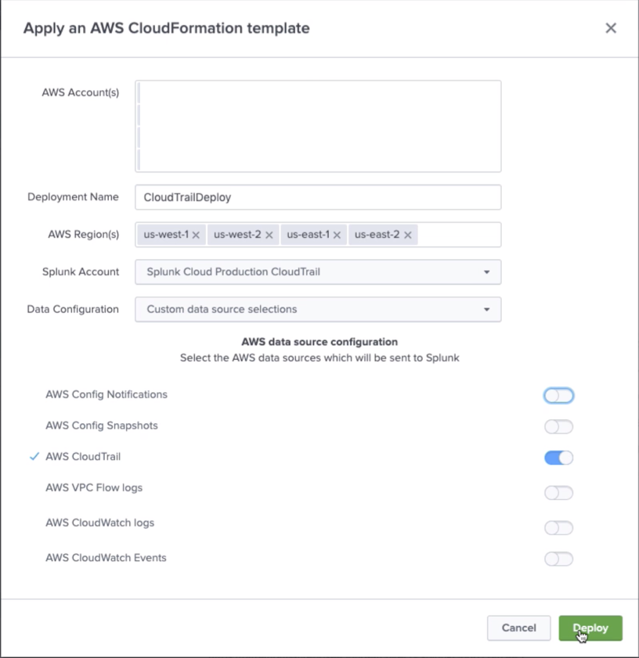
Select all the accounts
Give the deployment a name
Select all the regions
Send to your Splunk Endpoint
Select the data sources you want to send

Slide 19
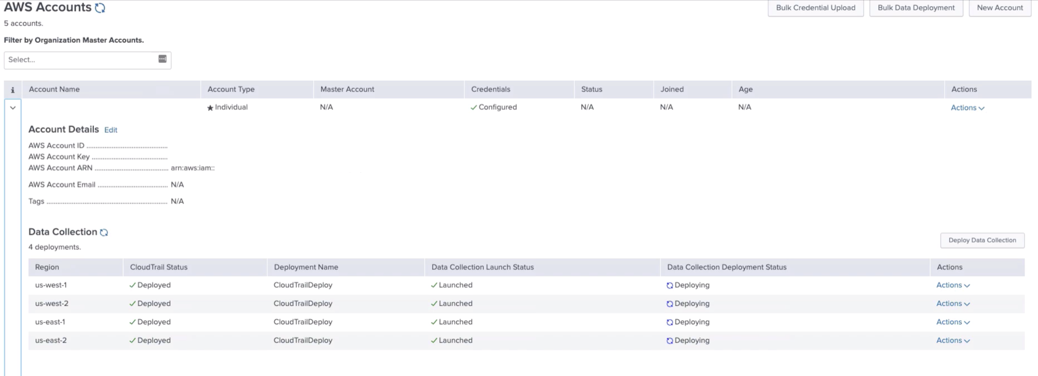

Slide 20
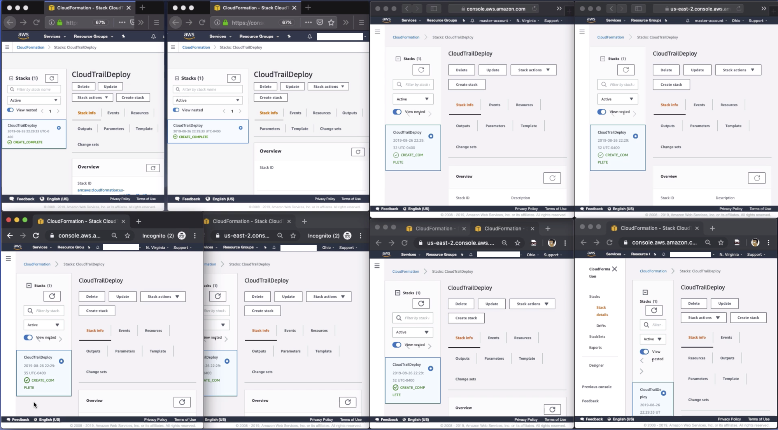

Slide 21
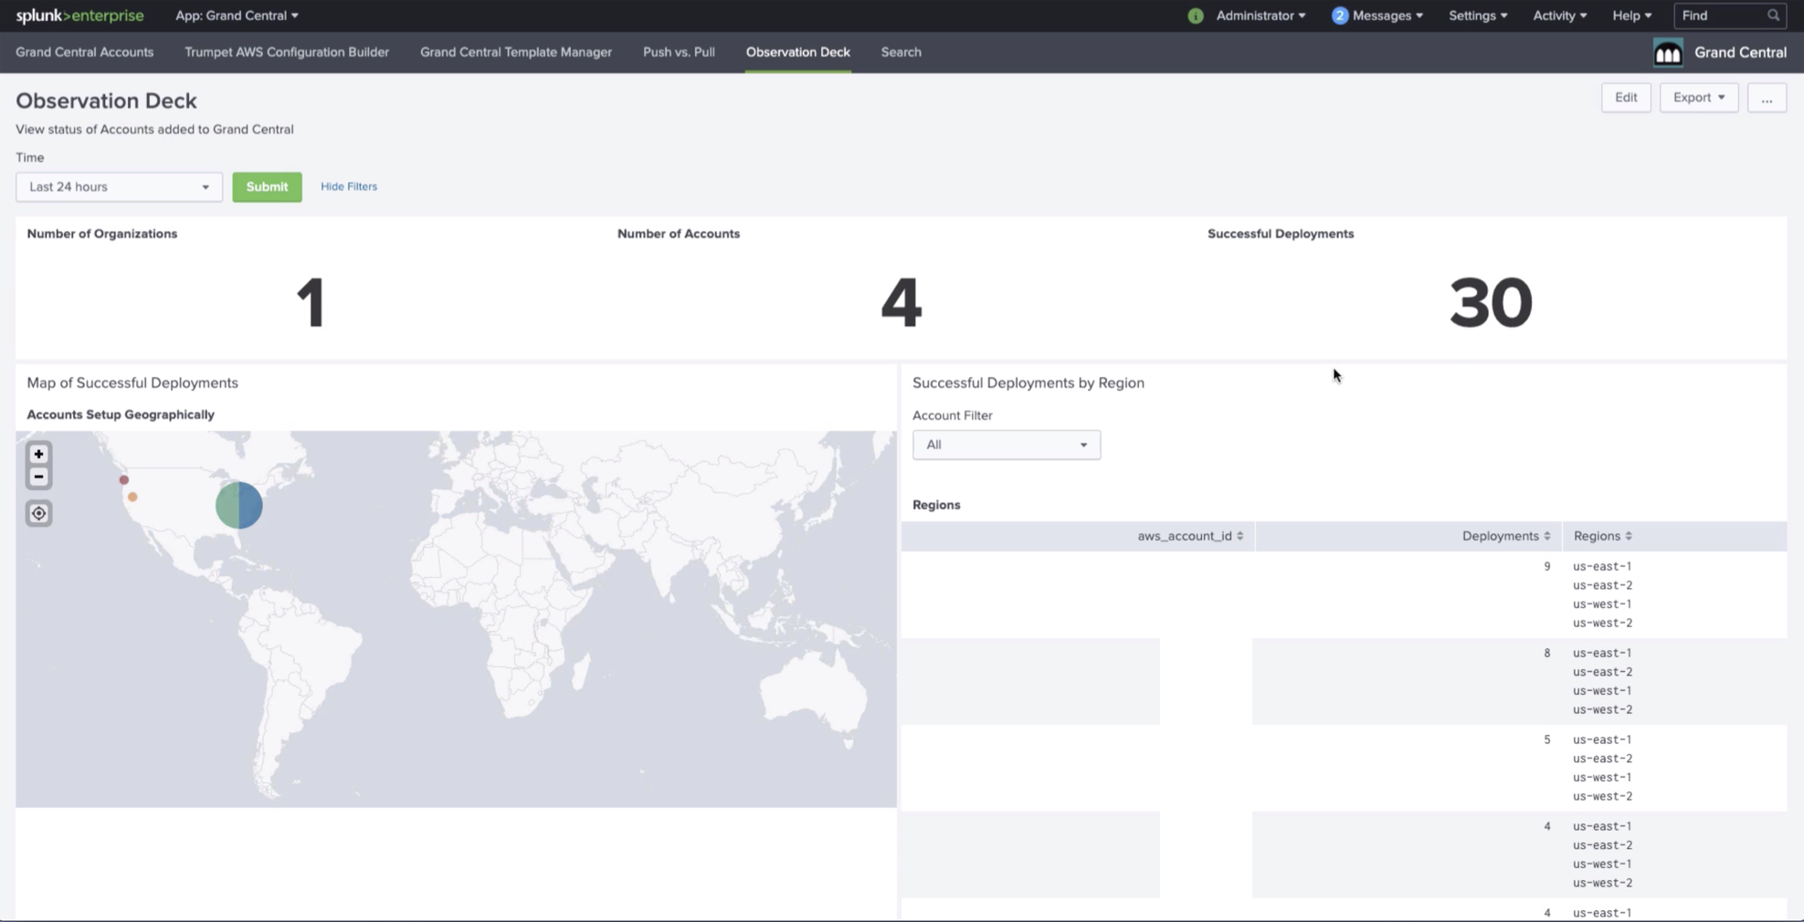

Slide 22
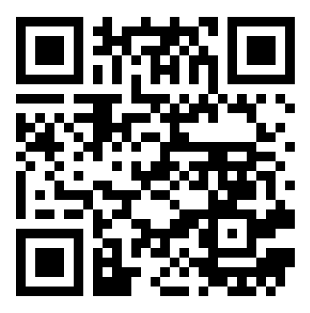
Available Today
Opensource license Version 1.1.1
https://github.com/amiracle/grand_central

Slide 23
Cloud Provider GDI
How to get data in from Cloud Proviers
Focus on AWS, GCP, and Azure

Slide 24

VPC Flow Logs
CloudWatch Logs
Lambda Function
Splunk HEC
Load Balancer
CloudTrail
CloudWatch Events
Kinesis Data Firehose
Splunk Firehose HEC
Push
Transport Latency
Lambda Function 0-10ms
Kinesis Data Firehose 10-150ms
Azure Function 10-150ms
GuardDuty
Config
Heavy Forwarder
SNS
S3 Bucket
SQS
Pull
Transport Latency
SQS Based S3 150-500ms
Modular Input 500-800ms
Description
StackDriver
Pub/Sub
Service Logs
Access Logs
CloudWatch Metrics
Stackdriver metrics
*LB Logs
GCS
Billing
Billing
*based on 100GB / day
EC2 Instance Logs
Universal Forwarder
Azure ATP
NSG Flow Logs
Azure VM Logs
Google VM
Blob
Splunk HEC
Load Balancer
Activity Log
Event Hub
Function
Diagnostic Logs

Slide 25
VPC Flow Logs
CloudWatch Logs
Lambda Function
Splunk HEC
Load Balancer
CloudTrail
CloudWatch Events
Kinesis Data Firehose
Splunk Firehose HEC
Pull
Transport Latency
SQS Based S3 150-500ms
Modular Input 500-800ms
GuardDuty
Config
Heavy Forwarder
SNS
S3 Bucket
SQS
Description
StackDriver
Pub/Sub
Service Logs
Access Logs
CloudWatch Metrics
Stackdriver metrics
*LB Logs
GCS
Billing
Billing
EC2 Instance Logs
Universal Forwarder
Azure ATP
NSG Flow Logs
Azure VM Logs
Google VM
Blob
Splunk HEC
Load Balancer
Activity Log
Event Hub
Function
Diagnostic Logs

Slide 26
VPC Flow Logs
CloudWatch Logs
Lambda Function
Splunk HEC
Load Balancer
CloudTrail
CloudWatch Events
Kinesis Data Firehose
Splunk Firehose HEC
Universal Forwarder
10:1 Compression
SSL Encryption
Cloud Agnostic
GuardDuty
Config
Heavy Forwarder
SNS
S3 Bucket
SQS
Description
StackDriver
Pub/Sub
Service Logs
Access Logs
CloudWatch Metrics
Stackdriver metrics
*LB Logs
GCS
Billing
Billing
EC2 Instance Logs
Universal Forwarder
Azure ATP
NSG Flow Logs
Azure VM Logs
Google VM
Blob
Splunk HEC
Load Balancer
Activity Log
Event Hub
Function
Diagnostic Logs

Slide 27
Long Term Plan
Collect all cloud data in a uniform path

Slide 28
Long Term GDI for Cloud
Template
Template
Template
Single template configures and collects the data from all the cloud providers.
Universal data collection.
Integrates with existing customer templates for collection.
Pull
Push

Slide 29
GDI Today

Slide 30
GDI : AWS

Slide 31

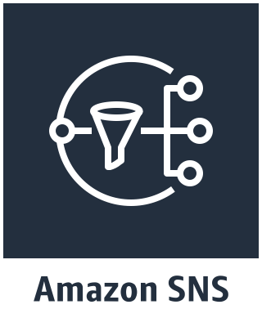
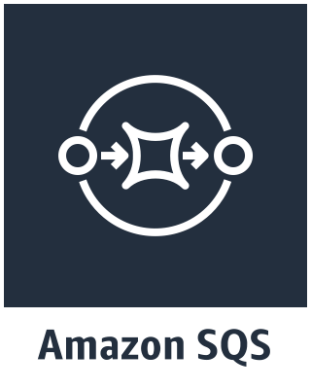



AWS Pull vs. Push
AWS Config and CloudTrail can be pulled with a Splunk Heavy Forwarder with the legacy modular input, SQS Based S3, Generic / Incremental S3. They can also be pushed with Kinesis Data Firehose through CloudWatch Events.
Pull
Push
HEC
SNS
Topic
Notification
SQS
Subscription
Notification
Event (event-based)
Splunk Pull
SQS Notification
Pulls Event from S3 Bucket
Config Events

Slide 32
AWS Source Matrix
Service | Source Type | Input Method | Data Requirement
CloudWatch Logs (VPCFLow) | aws:cloudwatchlogs:vpcflow | Lambda | Serverless, high volume
CloudWatch Logs (VPCFlow) | aws:cloudwatchlogs:vpcflow | Kinesis Data Firehose | Serverless, high volume, event validation
CloudWatch Logs (CloudTrail) | aws:cloudtrail | Kinesis Data Firehose | Serverless, high volume, event validation
CloudWatch Logs (CloudTrail) | aws:cloudtrail | SQS Based S3 (Pull) | High Volume, Pull required, no public endpoints exposed
Config | aws:config | SQS Based S3 (Pull) | High Volume, Pull required, no public endpoints exposed
Config | aws:config | Kinesis Data Firehose | Serverless, event validation
Description | aws:description | Modular Input | Collect description data
Inspector | aws:inspector | Modular Input | Collect inspector data
Access Logs | Aws:s3:acccesslogs | SQS Based S3 (Pull) | High Volume, Pull required, no public endpoints exposed
Load Balancer Logs | Aws:s3:{e|a|n}lb | SQS Based S3 (Pull) | High Volume, Pull required, no public endpoints exposed

Slide 33
GDI : Azure

Slide 34
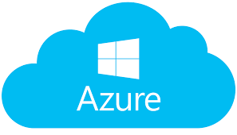
Azure Pull vs. Push
Splunk can pull data from Azure using a Heavy Forwarder and collect data from either the MS Blob or a REST API using the modular input. Azure can push data using the Event Hub to Azure Functions which can be sent to Splunk’s HEC.
Pull
Push
HEC
MSBlob
Activity Monitor
Event Hub
Azure Function
Splunk Indexers
REST
Splunk Indexers

Slide 35
GDI : Google Cloud

Slide 36
GCP Service Pull vs. Push
GCP Sends the data from StackDriver to PubSub where Splunk can pull data.
Pull
Push
HEC
Google
Service
StackDriver
PubSub
FUTURE
Splunk HF
Splunk Indexers

